Slide 1
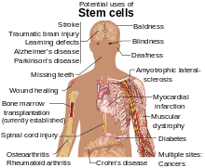
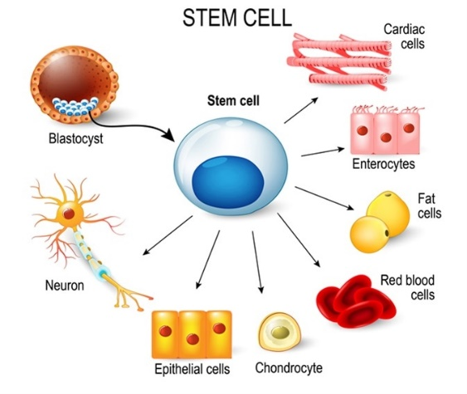
Stem Cell Therapy ( 10 days) Workshop
1 participant 6000 $
Group ( 2 people) 5500 $ per participant
Group ( 3 people) 5000 $ per participant
Group ( 4 people) 4500 $ per participant
Iran: +98 912 3369613 Kuwait: +965 676 48556 Sweden: +46 79010810
Turkey: +90 (312) 428 48 14 +90 (312) 428 36 90 Emirate: +97 1044432346

